Slide 1
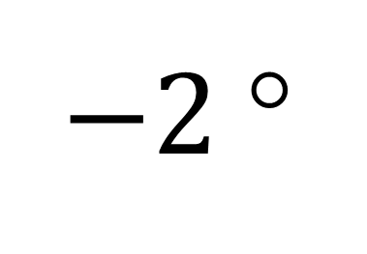
$−2$°
t = 600 s

